Slide 1
Sequence tagging
Kevin Lybarger, PhD
Fall 2021

Slide 2

Sequence Tagging
$X$ = typically a sentence but could be a paragraph or document
Variable length sequence of words
$f\left(X\right)∈\left\{1,2,…,k\right\}$
Labels are assigned to each token
null
Present
null
null
Frequency
Characteristic
Symptom
null
Classifier
Patient
reports
new
,
frequent
dry
cough
.
Patient reports new, frequent dry cough.

Slide 3
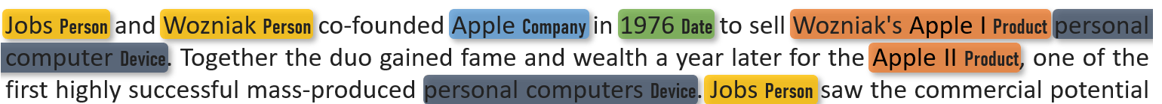
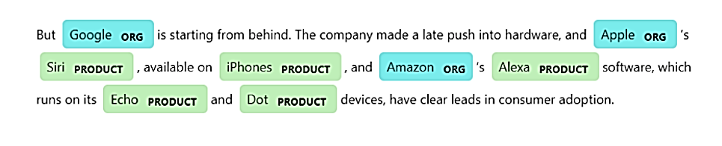
Named Entity Recognition (NER)
https://www.innoplexus.com/blog/what-is-named-entity-recognition/
https://www.johnsnowlabs.com/named-entity-recognition-ner-with-bert-in-spark-nlp/

Slide 4
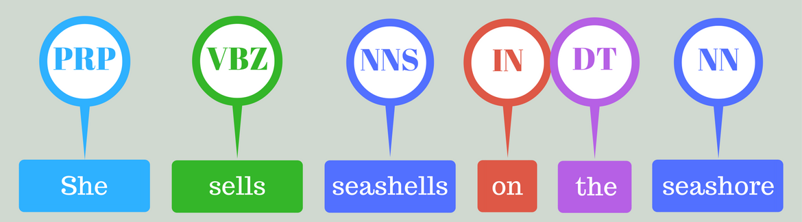
Part of Speech (POS) Tagging
Multi-class classification problem
Incorporate POS in other classification task
Utility less clear with deep learning
https://nlpforhackers.io/wp-content/uploads/2016/08/Intro-POS-Tagging.png
PRP | Personal pronoun
VBZ | Verb, 3rd person singular present
NNS | Noun, plural
IN | Preposition or subordinating conjunction
DT | Determiner
NN | Noun, singular or mass

Slide 5
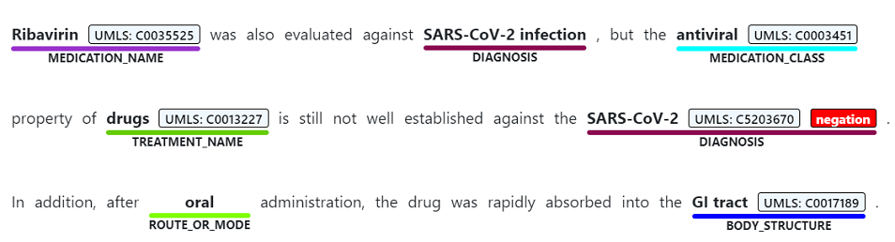
Medical Concept Extraction
Identify and label spans (phrases)
Labels often mapped to ontologies
https://docs.microsoft.com/en-us/azure/cognitive-services/text-analytics/how-tos/text-analytics-for-health?tabs=ner

Slide 6
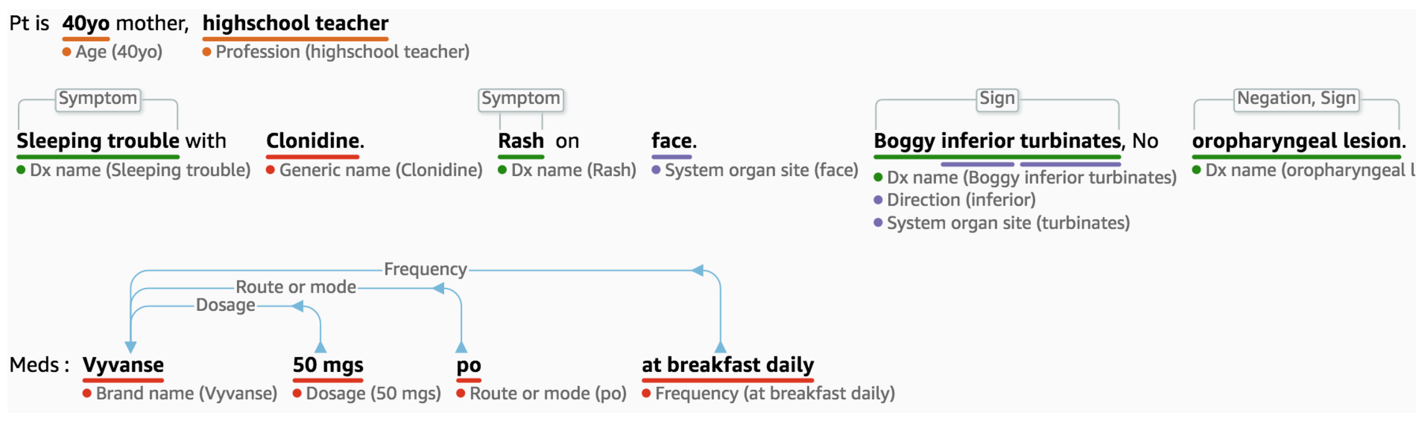
Medication Disposition & Adverse Drug Interaction
Bhatia P, et al. Comprehend medical: a named entity recognition and relationship extraction web service. IEEE ICMLA 2019 Dec 16.

Slide 7
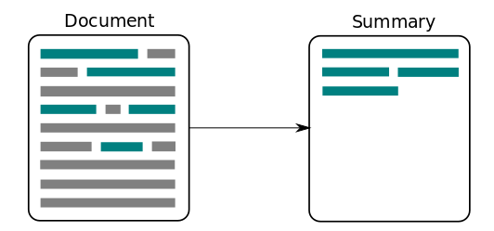
Extractive summarization
Summarization
Extractive – Use portions of source text to build summary
Abstractive – Generate new text summarizing document
https://medium.com/@ondenyi.eric/extractive-text-summarization-techniques-with-sumy-3d3b127a0a32

Slide 8
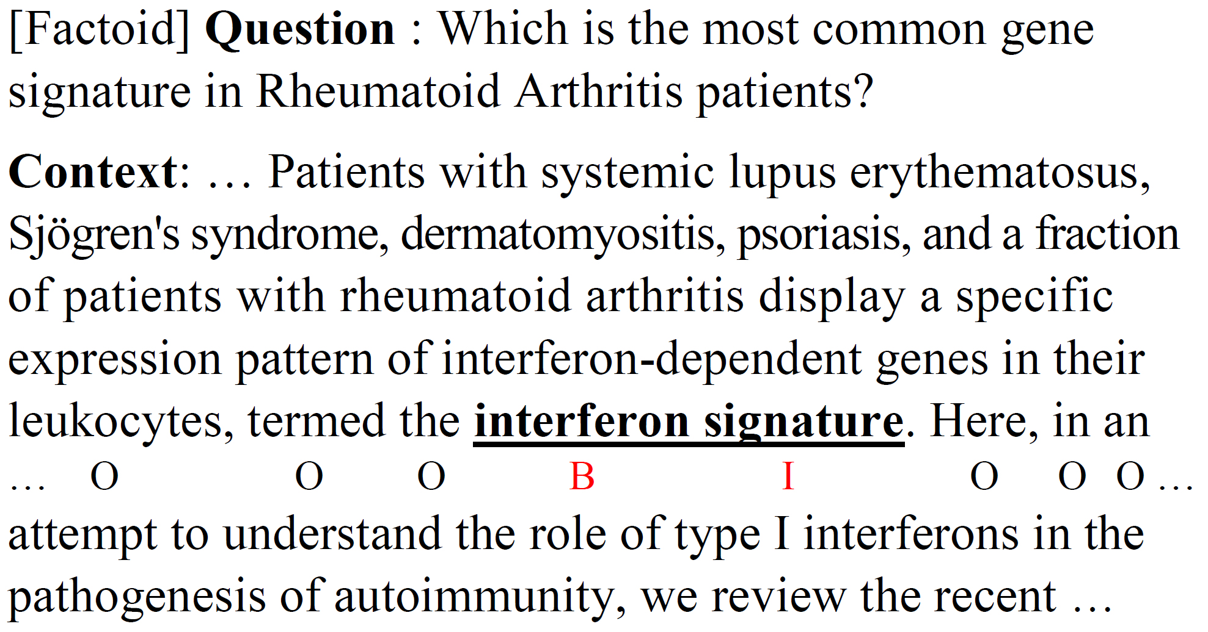
Question Answering
Extracted question answering
Given a question related to a passage, find the answer
Yoon W, Jackson R, Kang J, Lagerberg A. Sequence Tagging for Biomedical Extractive Question Answering. arXiv preprint arXiv:2104.07535. 2021 Apr 15.

Slide 9
Many other problems
Detecting errors in speech recognition
Chunking text into topically relevant sections
and many more…
He Z, Wang Z, Wei W, Feng S, Mao X, Jiang S. A Survey on Recent Advances in Sequence Labeling from Deep Learning Models. arXiv e-prints. 2020 Nov:arXiv-2011.

Slide 10
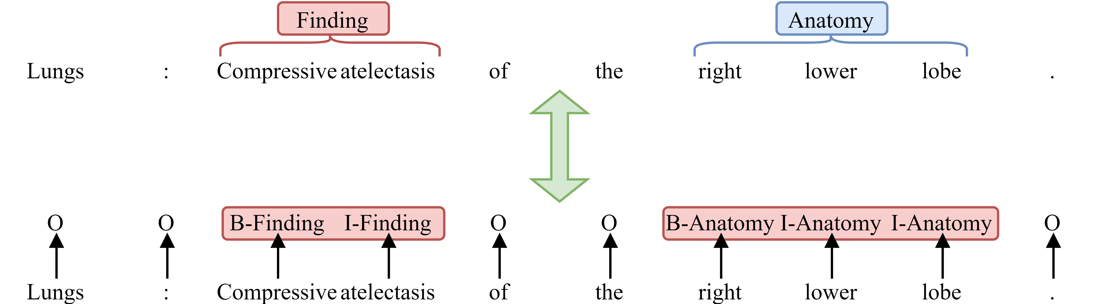
Tokens vs. Spans
Begin-inside-outside (BIO) tags
Other versions, BIOE, BIOES, …

Slide 11
Discrete modeling
Conditional random fields (CRF)
By far the most popular
Hidden Markov model (HMM)
Support Vector machines (SVM)
and many more…

Slide 12
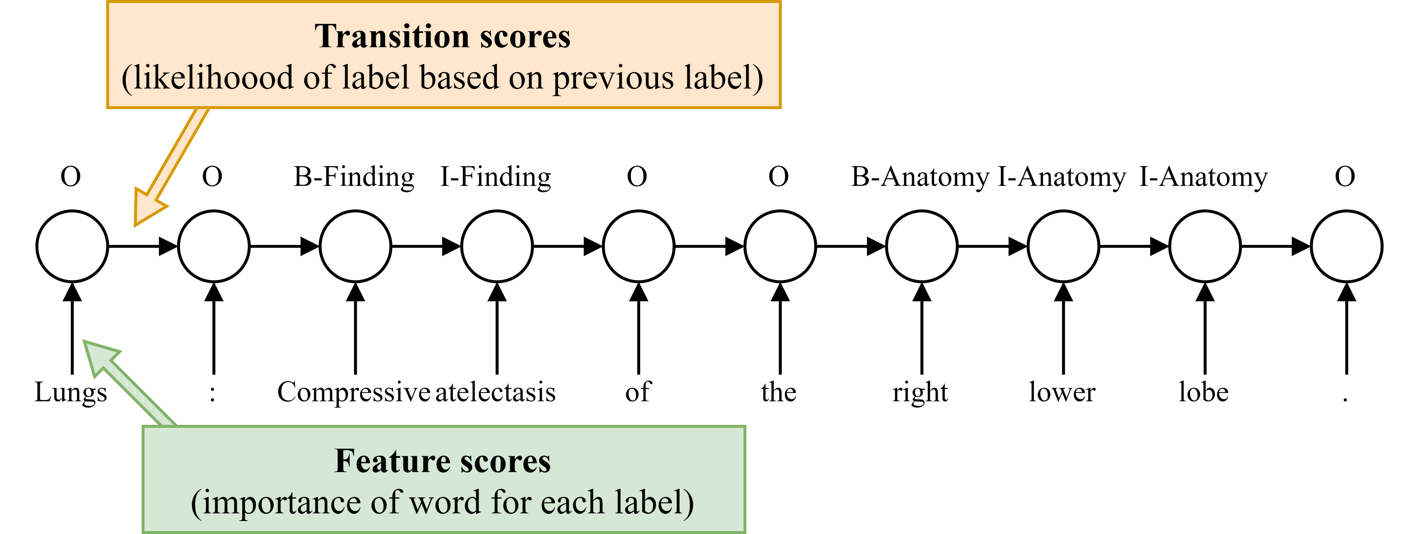
Conditional random fields (CRF)
Predicts labels based on current observation(s) and previous predictions

Slide 13
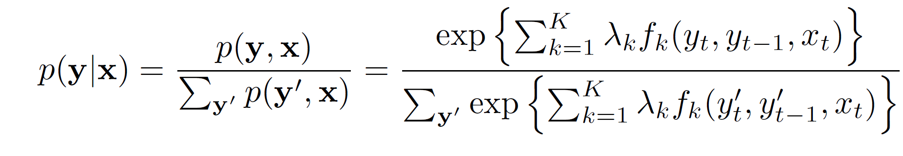
CRF
Discriminative undirected probabilistic graphical model
p(labels|observations) → p(y|x)
Sutton C, McCallum A. An introduction to conditional random fields for relational learning. Introduction to statistical relational learning. 2006;2:93-128.

Slide 14
(Shallower) neural networks
Recurrent neural networks (RNN)
Long short-term memory networks (LSTM)
Bidirectional LSTM (biLSTM)
biLSTM+CRF

Slide 15
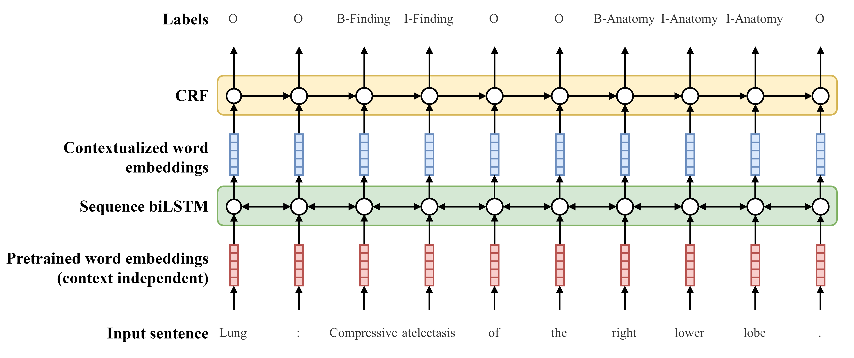
LSTM+CRF

Slide 16
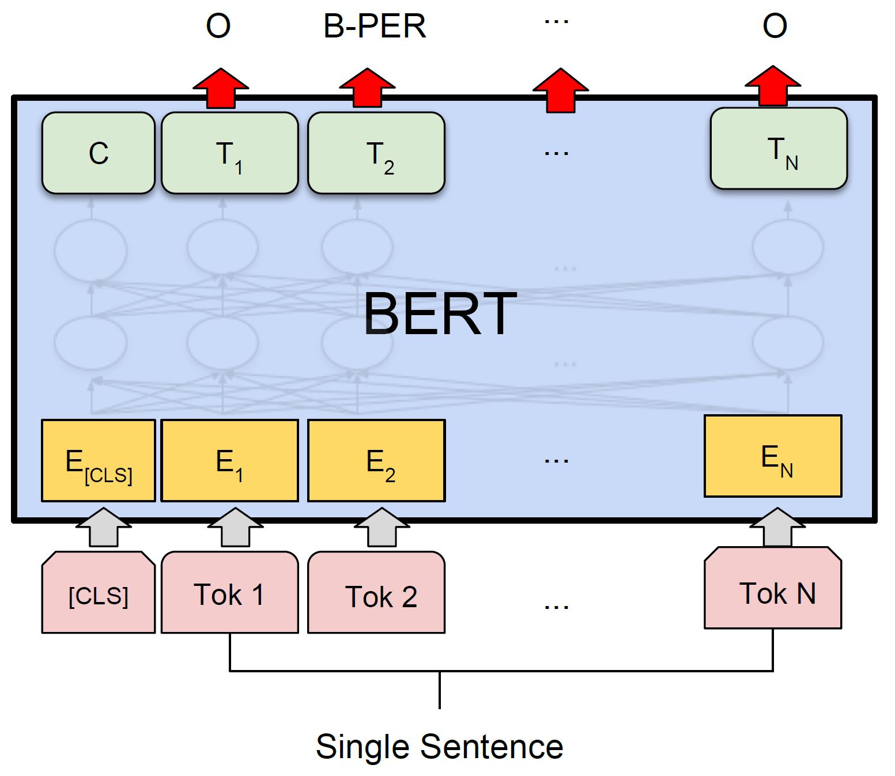

Deep neural networks
BERT
Add linear layer
$y=W×T+b$
W has dim. (|y|, |T|)
b has dim. (|y|)
BERT+CRF
BERT+LSTM
and many more
Devlin J, Chang MW, Lee K, Toutanova K. BERT: Pre-training of Deep Bidirectional Transformers for Language Understanding. InNAACL-HLT (1) 2019 Jan 1.

Slide 17

Parameter case study
Given
Training vocab, $|V|=20k$
Annotated label set, {Finding, Anatomy}
BIO label set, y∈{O, B-Finding, I-Finding, B-Anatomy, I-Anatomy} (|y|=5)

Slide 18
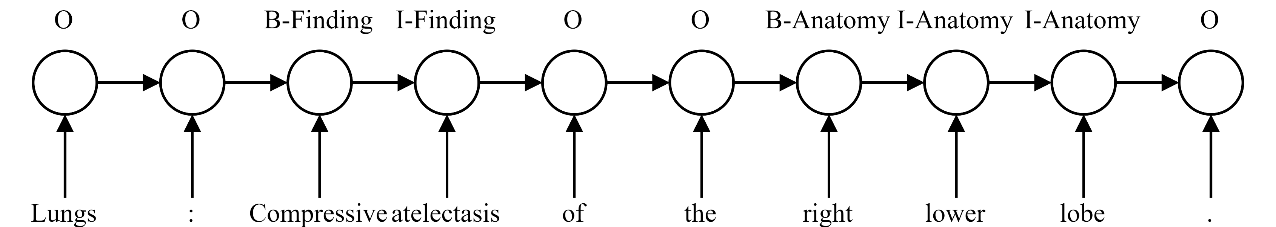
CRF
k indicates the (y_{t}, y_{t-1}, x_{t}) combination
# of (y_{t}, y_{t-1}) = |y|² = 25
# of x_{t} = |V| = 20k
# of k = 25*20k = 500k
|λ|=500k
500k learned parameters
No pretraining

Slide 19
LSTM+CRF
Word embeddings
Pre-trained on unlabeled corpora
d ~100-500
millions of parameters, but pre-defined
BiLSTM
Hundreds of thousands-millions of parameters
NO pre-training
Must be learned on training set
CRF
# of x_{t} = |h|≈100-500
# of k ≈ 2.5k-12.5k
NO pre-training
Must be learned on training set

Slide 20
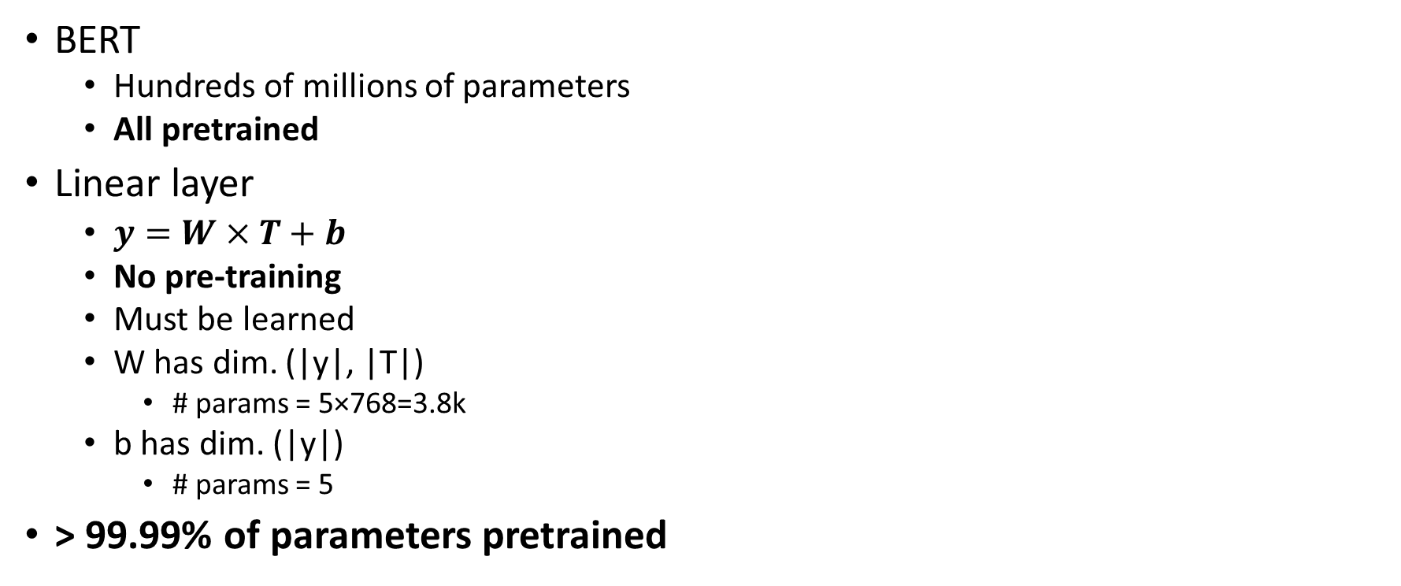
BERT
BERT
Hundreds of millions of parameters
All pretrained
Linear layer
$y=W×T+b$
No pre-training
Must be learned
W has dim. (|y|, |T|)
# params = 5×768=3.8k
b has dim. (|y|)
# params = 5
> 99.99% of parameters pretrained

